Slide 1
Research and Implementation of Virtual Mentor Models in Programming
Real-time personalized feedback for first-year students Master's student research work #2, 2025-2026 academic year Alimzhan Koshikov, 7M06105 Computer Science and Engineering Supervisor: Tutkyshbayeva Shyryn, PhD, Astana IT University
Dissertation topic: Исследование и реализация моделей виртуального наставника по программированию с персонализированной обратной связью студентам первого курса в реальном времени
1

Slide 2
1. Relevance of the Research / Актуальность исследования
Delayed help in CS1
Beginners often need feedback at the exact moment they are stuck, not after grading.
Research gap
Need feedback that is immediate, personalized, and bounded by learning goals.
The mentor must decide how to intervene before generating the wording.
The key technical layer is a feedback-state / policy decision model.
Static tools are limited
Compilers and tests report failure, but rarely explain the student's misconception.
Code state
Code feedback state
Personalized and bounded hint
Unrestricted LLMs are risky
Open-ended assistants can over-explain or reveal near-solutions without pedagogical control.
Core idea: feedback generation should be controlled by an explicit pedagogical policy, not by an unrestricted language model.
2

Slide 3
2. Methods and Initial Data / Методы и исходные данные
Literature review
CS1 learning difficulties, automated feedback, AI tutors, LLM guardrails
Supervised ML
Feedback-state prediction with problem-level holdout and ablation study
Software prototyping
Spring Boot backend, Vue frontend, PostgreSQL, FastAPI ML policy service
Evaluation design
Offline Codeforces evaluation plus SocratesAI interaction logs for future CS1 testing
Main data used
178,414
Python submissions
872
beginner Codeforces problems
5
feedback states
12
MVP benchmark tasks
2026-2027
classroom validation
5

Slide 4
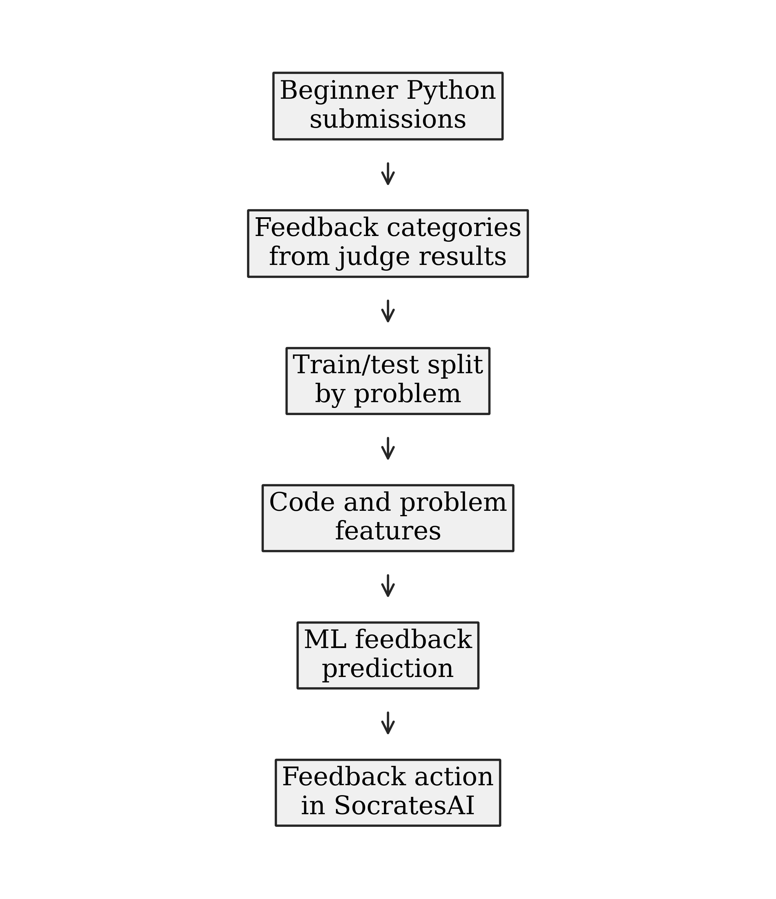
3. ML Decision Layer / Слой принятия решения
From submission to mentor action
Beginner submissions are grouped into feedback categories from judge/run outcomes.
Train/test split is performed by problem to reduce leakage across similar attempts.
The predictor estimates the feedback state before the mentor writes the hint.
SocratesAI uses the state and confidence to guide bounded feedback generation.
Analyzer
Policy
Feedback
6

Slide 5
4. SocratesAI MVP Architecture / Архитектура прототипа
Analyzer signals
Student UI Vue 3
REST / WebSocket Spring Boot
Session context
Policy selector
ML
Feedback Template / LLM
interaction_logs PostgreSQL
Task + run results
7

Slide 6
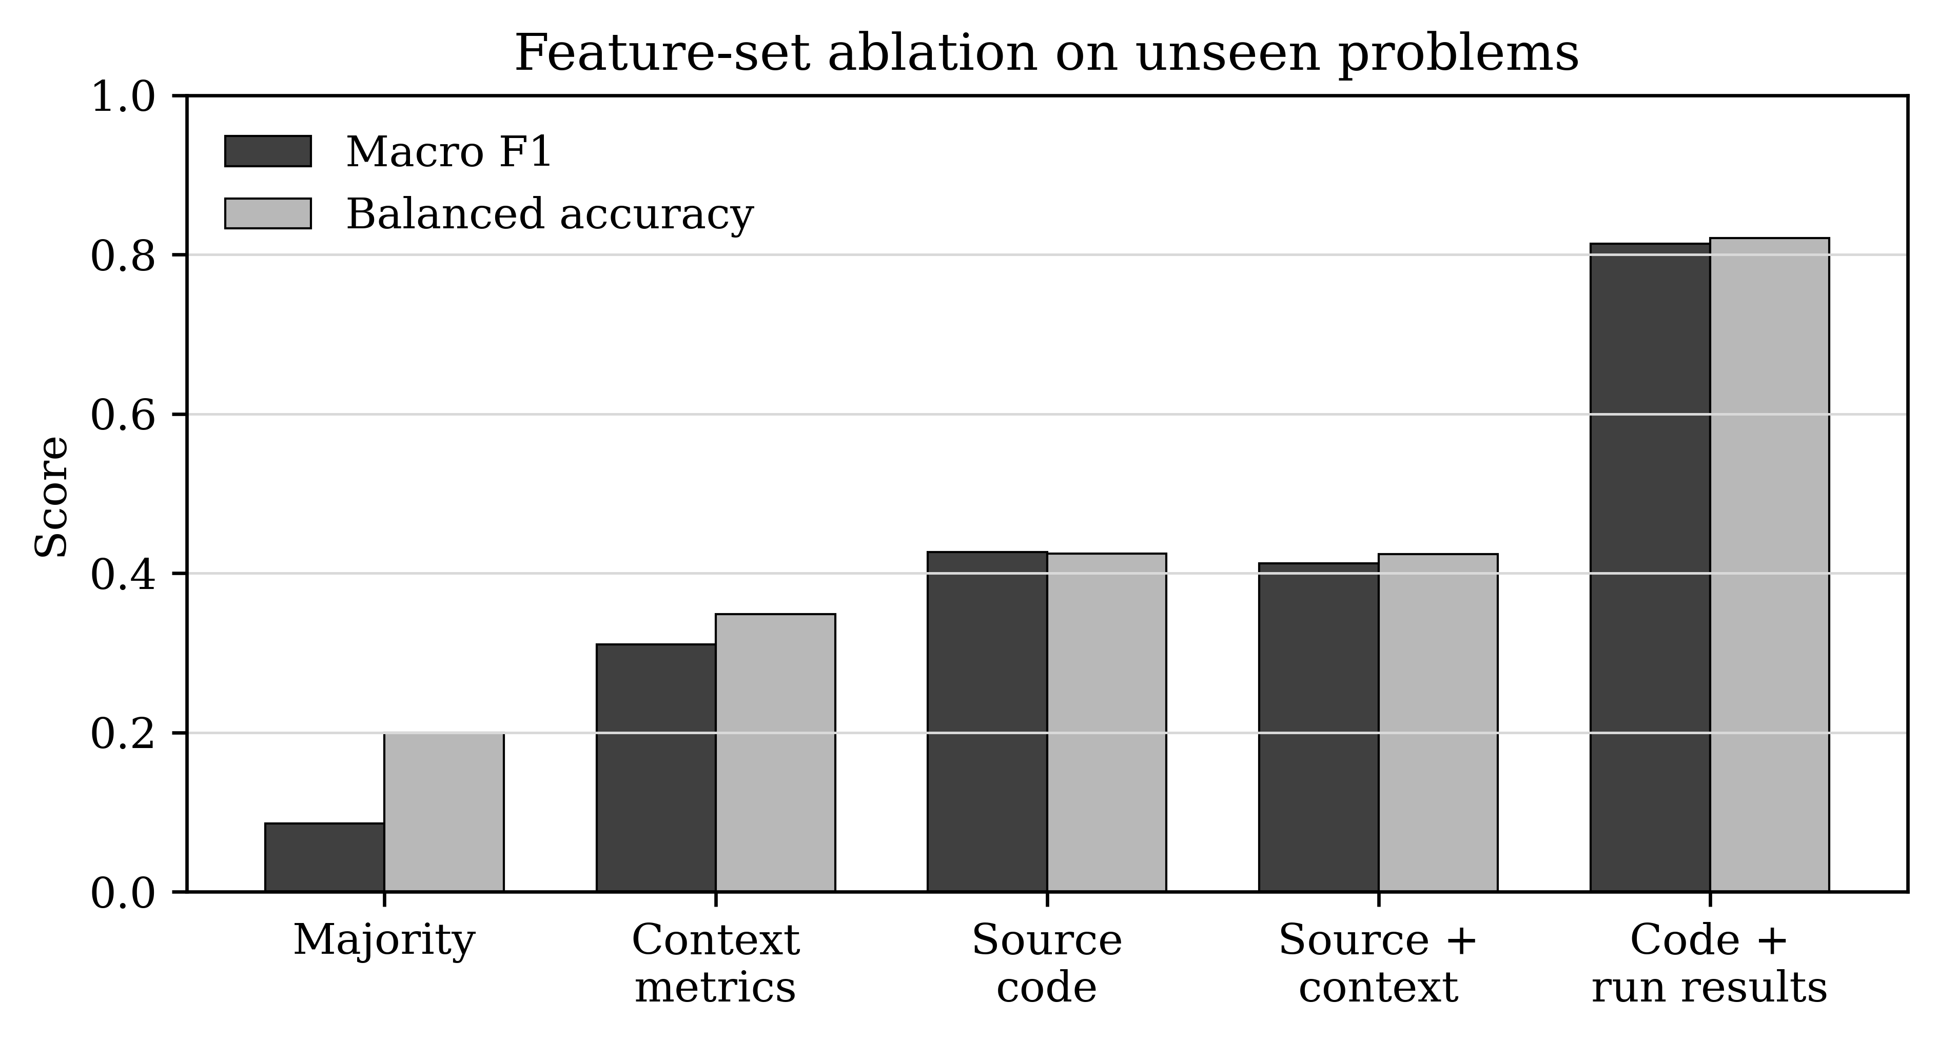
5. Empirical Results / Результаты ML-эксперимента
0.085
majority baseline macro F1
0.426
source-code model macro F1
0.814
code + run model macro F1
872
held-out problem setting
178,414
submissions evaluated
Interpretation
Source code contains useful early signals for personalized mentoring.
Execution results substantially improve reliable state prediction.
Problem-level holdout makes the evaluation stricter than random splitting.
9

Slide 7
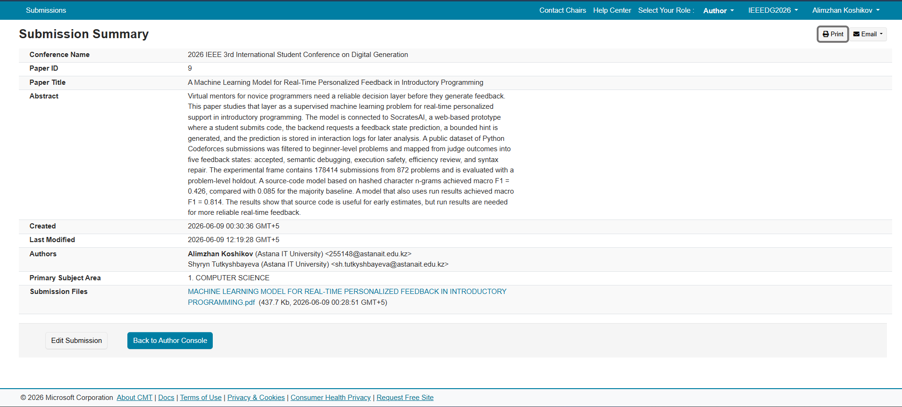
6. Plan Implementation and Publication / Результаты ИПРМ
Publication output
"A Machine Learning Model for Real-Time Personalized Feedback in Introductory Programming" - submitted to the 2026 IEEE 3rd International Student Conference on Digital Generation.
Research internship
Research internship has been postponed and rescheduled to 2027 in AITU Research Center (НИЦ AITU)
Jan-Mar 2026
Mar-Apr 2026
Mar 2026
Apr-Jun 2026
Jun 2026
May-Jun 2026
Literature review and theoretical basis
SocratesAI concept and architecture
SIST 2026 manuscript reviewed
Technical redirection to ML decision layer
IEEE student conference manuscript
MVP and initial experiments
completed
completed
not accepted; feedback considered
completed
submitted
completed; pilot planned
12

Slide 8
Conclusion / Заключение
What has been achieved
The research direction was corrected toward a measurable technical layer. The MVP now connects code analysis, policy selection, bounded feedback, and interaction logging.
Main scientific result
Feedback-state prediction is feasible on a problem-level holdout: source code already improves strongly over baseline, and code-plus-run signals reach the best result.
Next stage
Collect target-domain SocratesAI logs, run CS1 classroom experiement, refine the taxonomy, and complete the implementation/results chapters.
Dissertation defense deadline: 2027. The current work provides the technical foundation; the planned classroom study will test learning outcomes.
13

